Slide 1
Yogyakarta Trend and Bakpia Location
Thomas Theo
thomas.t@outlook.co.id
Yogyakarta, Indonesia

Slide 2
Yogyakarta
Background
Yogyakarta is arguably the cultural capital city of Indonesia, particularly Javanese culture. The city and province, are still ruled by a monarchy, an anomaly in the 21th century.
Home for plethora of incredible buildings, landmarks, and monuments.
Borobudur temple, one of the Seven Wonders are located in the nearby city of Magelang;
Prambanan temple, and
Kraton Yogyakarta.
The city are also famous for its culinary heritage that's distinct from the other region, with food such as:
'Gudeg', and
'Bakpia', Bakpia is a pastry filled with numerous filings, the classic and the most famous filling are green peas (mung beans), but other flavor and brand has innovate and produce numerous other fillings as well, e.g. chocolate, cheese, even durian. Bakpia is usually bought as a souvenirs from the city.

Slide 3
Objective
Find bakpia location in Yogyakarta;
Explore trending venues in Yogyakarta so it can help tourist prioritize their trips.

Slide 4
Data acquisition
Yogyakarta coordinates that’s obtained from geopy.geocoders and Nominatim;
Foursquare API using client id and client secret to explore trending venues in Yogyakarta and to find bakpia store in Yogyakarta. Foursquare API website: https://developer.foursquare.com/ ;
analyze data got through Foursquare.

Slide 5
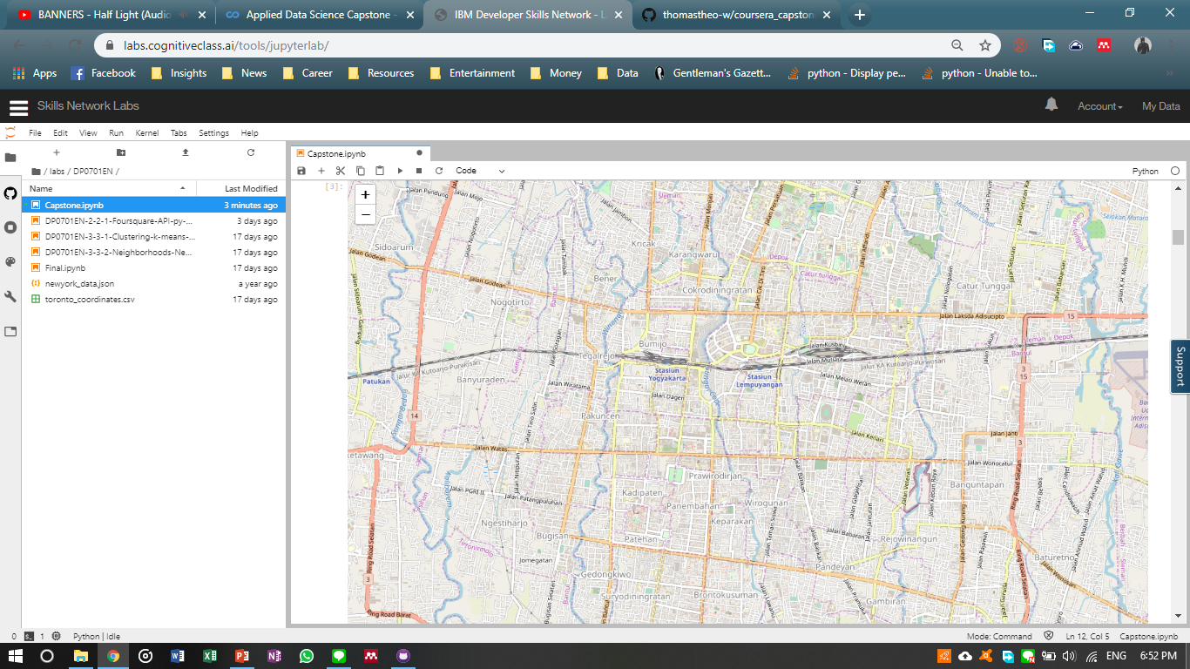
Yogyakarta Map generated by Folium

Slide 6
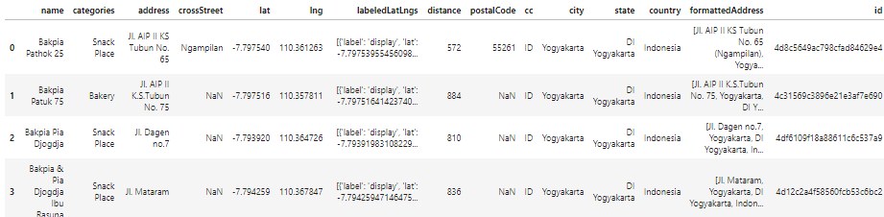
List of Bakpia Stores in Yogyakarta using Foursquare API (samples, using head function after cleaned)

Slide 7
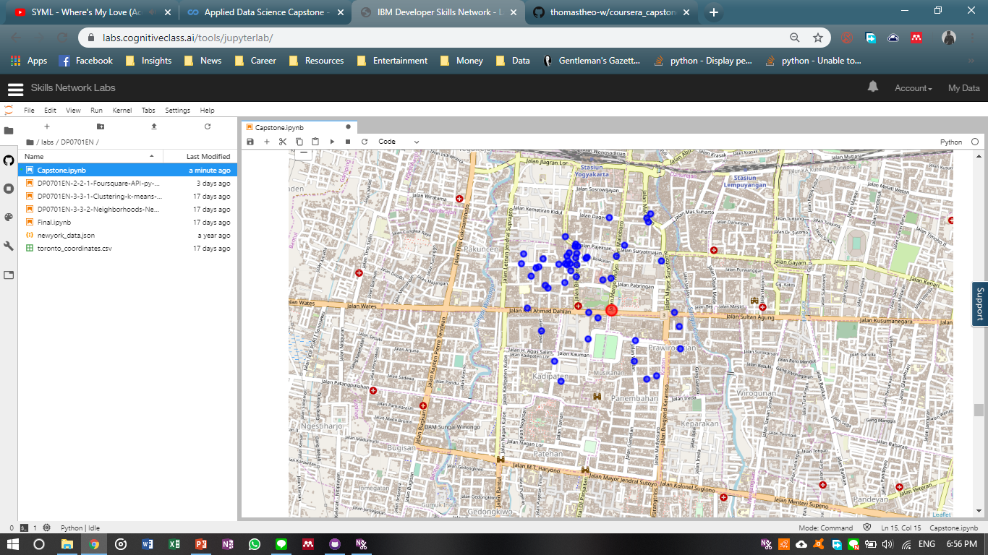
Map of Bakpia Stores in Yogyakarta using Folium
Legend
Blue dots: Bakpia Stores
Red dots: Yogyakarta

Slide 8
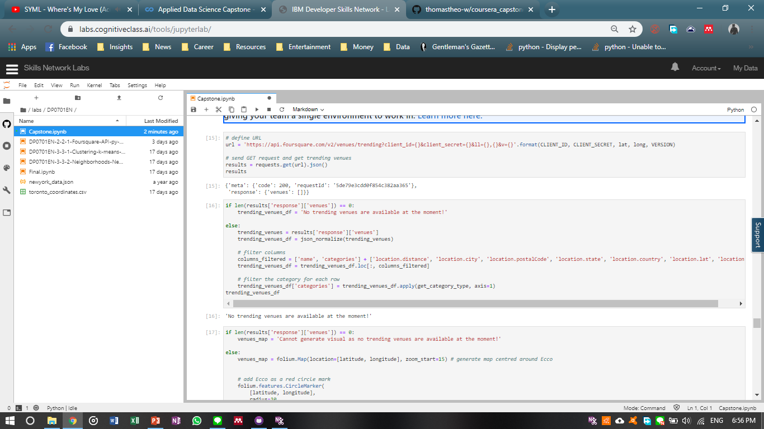
Checking Yogyakarta’s Trending Venues
Conclusions
Currently, there are no trending venues in Yogyakarta

Slide 9
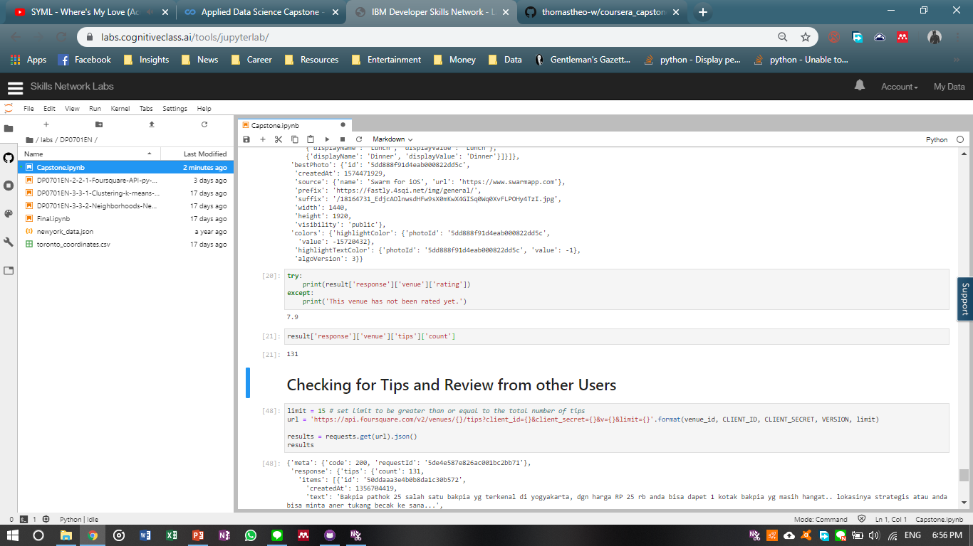
Checking for Venues Rating
(only an example of a store called Bakpia Pathuk 25)

Slide 10
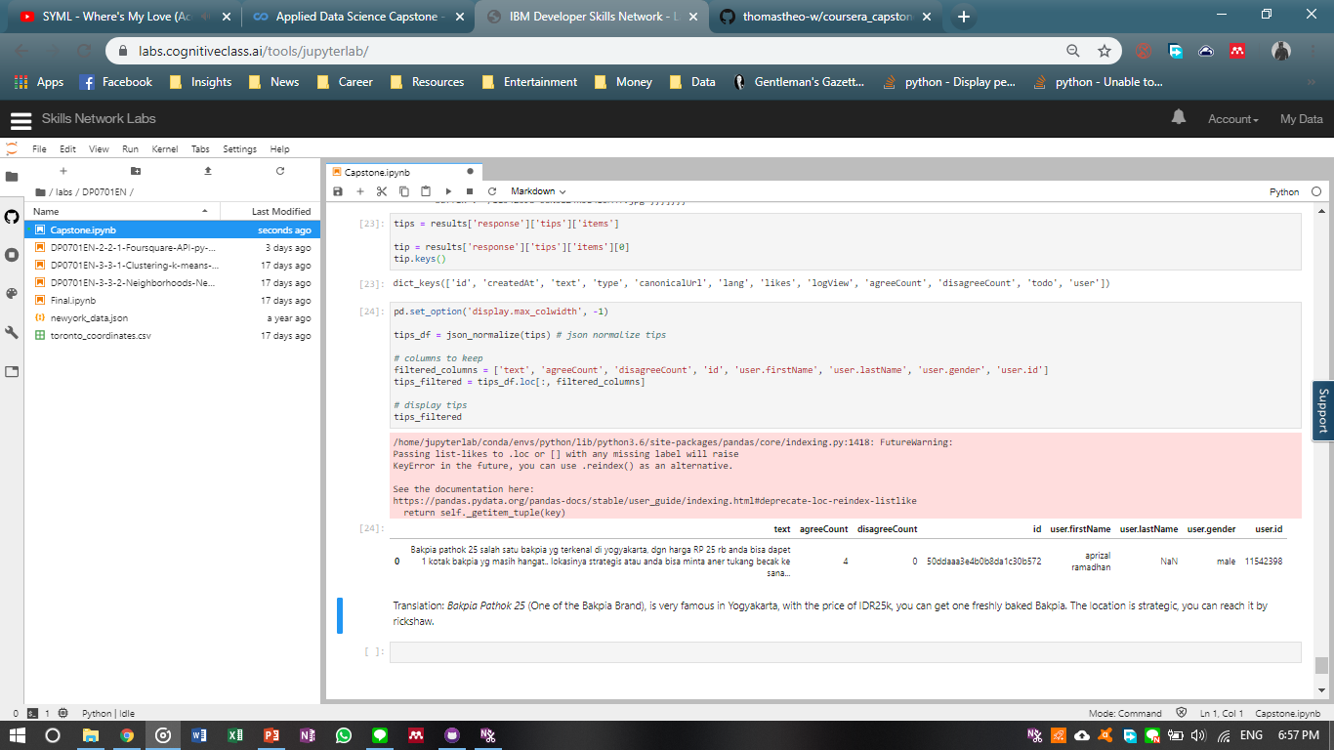
Checking Bakpia Pathok 25 (an example) Review’s

